Slide 1
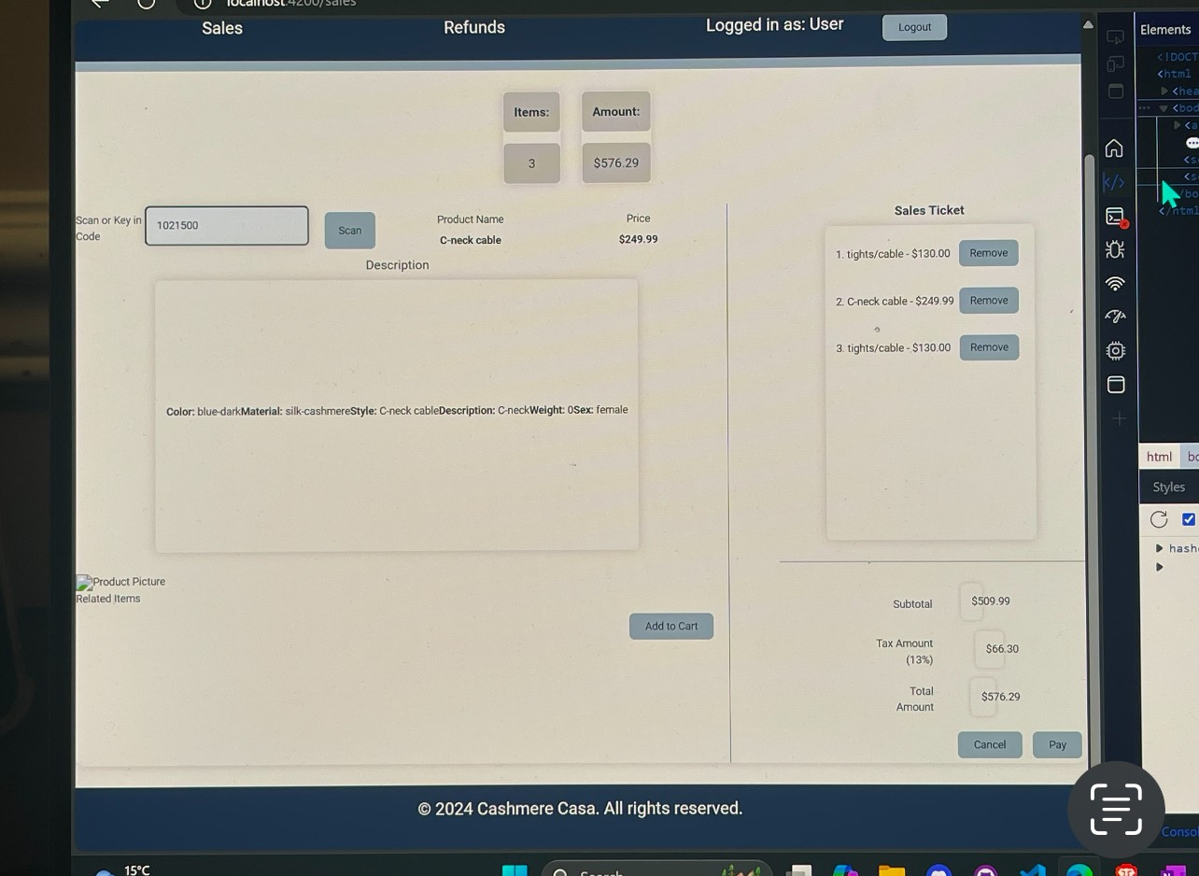

1
Center align test
Move text to top of box
Align
Change remove to icon
Reduce inter – line spacing
Cut description height by 75%
Align text in description to top left
Box for images – if not images
Available write no images available
Add Clear button
Look atsales ticket layout
2
4
Scan or Key in Code
5
3
10
Clear

Slide 2

Sales Ticket
Code
Cashmere Dress
$ 300.23
Scroll bar if data exceeds space
Code
Cashmere Dress
$ 300.23
Code
Cashmere Dress
$ 300.23
Items
5
Amount
Code
Cashmere Dress
$ 300.23
$1696.30
Code
Cashmere Dress
$ 300.23
Sub Total
Tax
HST 125456
Total
$ 1501.15
$ 195.15
$ 1696.30
Cancel
Pay

